Slide 1
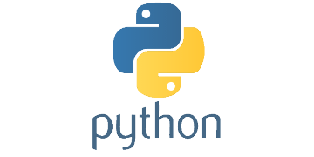
Python Primer
3
- Dr. Sifat Momen (SfM1)

Slide 2
Learning goals
After this presentation, you should be able to
Write Simple Python Codes
Write Python Functions
Write Classes, and objects in Python
Apply the concept of inheritance and multiple inheritance in Python
Understand and apply list comprehension
Apply list slicing in Python

Slide 3
Jupyter Notebook
Please note that this presentation has an accompanying Jupyter notebook.
You should use the Jupyter notebook in parallel with this presentation for effective learning

Slide 4
Hello World
#Print Hello World in Python
print ("Hello World")
#Print Hello World in Python
print('Hello World')

Slide 5
Simple Arithmetic Computation
#Do Simple computations like add two numbers, subtract one from another
3 + 5
1 - 4
1 + (4*5)%2
9//2
11//3
#Do Simple computations like add two numbers, subtract one from another
print(3 + 5)
print(1 - 4)
print(1 + (4*5)%2)
print(9//2)
print(29//10)
print(3*"Hello World ")

Slide 6
Functions in Python
#Write a function in Python to return the largest number in the array
def find_largest(arr):
largest = arr[0]
for num in arr:
if num > largest:
largest = num
return largest
# It is possible to create arrays in different ways. One of the ways is using a list
# Lists, in Python, are mutable -- meaning you can change their elements
myArray = [1, 3, 7, 2, 4, 6, 2]
print(find_largest(myArray))

Slide 7
Functions in Python
# Write a Python code to print the contents in an array and also print out the length of the array
for num in myArray:
print(num)
print('Length of the array: ', len(myArray))

Slide 8
Function to remove duplicate items in an array
def remove_duplicates(arr):
return list(set(arr))
# Another way to do this is by using a for loop and an empty #list to keep track of the unique elements:
def remove_duplicates2(arr):
unique_list = []
for item in arr:
if item not in unique_list:
unique_list.append(item)
return unique_list
myArray = remove_duplicates(myArray)
myArray = remove_duplicates2(myArray)

Slide 9
Function to compute n!
# Recursive Solution
def factorial(n):
if n == 0:
return 1
else:
return n * factorial(n-1)
# Here is an iterative solution
def factorial2(n):
result = 1
for i in range(1,n+1):
result *= i
return result

Slide 10
Range
Use help(range) or dir(range) to understand what it does
# Let's explore the range function
x = range(1, 4)
for item in x:
print(item)
1
2
3
# rangeobject.count(value) -> integer -- return number of occurrences of value
print(x.count(1))
print(x.count(0))
1
0

Slide 11
Python Function to compute the nth Fibonacci number
def fibonacci(n):
if n <= 0:
return 0
elif n == 1:
return 1
else:
return fibonacci(n-1) + fibonacci(n-2)
What will be printed?
x = range(1, 6)
for item in x:
print("fib(", item, ") = ", fibonacci(item))
From CSE 373, recall that this is an exponential time algorithm

Slide 12
More Efficient DP (bottom up) solution
# Here's the code that utilizes DP (bottom up approach)
def fibonacci2(n):
if n <= 0:
return 0
elif n == 1:
return 1
else:
fib = [0]*(n+1)
fib[1] = 1
for i in range(2, n+1):
fib[i] = fib[i-1] + fib[i-2]
return fib[n]

Slide 13
Reverse sort an Array
def reverse_sort(arr):
return sorted(arr, reverse=True)
def reverse_sort2(arr):
arr.sort(reverse=True) # this function sorts the given array in place
return arr

Slide 14
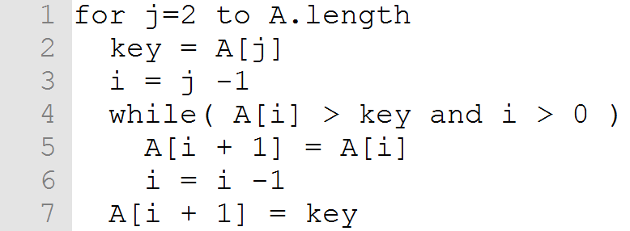
Insertion Sort Implementation in Python
def insertion_sort(arr):
for j in range(1, len(arr)):
key = arr[j]
i = j-1
while arr[i] > key and i > -1 :
arr[i + 1] = arr[i]
i -= 1
arr[i + 1] = key
return arr

Slide 15
Zip Function in Python
list1 = [1, 2, 3]
list2 = [4, 5, 6]
list3 = [7, 8, 9]
zipped = zip(list1, list2, list3)
print(list(zipped))
[(1, 4, 7), (2, 5, 8), (3, 6,9)]

Slide 16
Zip function in Python
list1 = [1, 2, 3]
list2 = [4, 5, 6]
list3 = [7, 8, 9]
for a, b, c in zip(list1, list2, list3):
print(a, b, c)

Slide 17
Classes and Objects in Python
class Bird:
def __init__(self):
self.flying_speed = 0
def fly(self, speed):
self.flying_speed = speed
print("Flying at {} km/h".format(speed))
A Class called Bird in Python

Slide 18
Subclass
class Hawk(Bird):
pass
Here’s a subclass called Hawk that inherits from the superclass Bird but does not have any additional functionality
class Hawk(Bird):
def __init__(self):
Bird.__init__(self)
self.vision_distance = 0
def set_vision_distance(self, distance):
self.vision_distance = distance
print("Hawk can see up to {} km away".format(distance))
Here’s a subclass called Hawk that inherits from the superclass Bird and have additional functionalities

Slide 19
Object
# Let's create an object of the Hawk class and call all its methods
hawk = Hawk()
hawk.fly(50) # prints "Flying at 50 km/h"
hawk.set_vision_distance(2) # prints "Hawk can see up to 2 km away"

Slide 20
Multiple Inheritance in Python
class Parent1:
def method1(self):
print("Method 1 of Parent 1")
class Parent2:
def method2(self):
print("Method 2 of Parent 2")
class Child(Parent1, Parent2):
pass

Slide 21
List Comprehension in Python
#Create a list with numbers from 0 to 99 in it
ls1 = []
for item in range(100):
ls1.append(item)
print(ls1)
ls2 = [item for item in range(100)]
print(ls2)

Slide 22
List Comprehension in Python
# Create another list containing odd numbers from ls1
oddList = []
for x in range(100):
if(x%2==1):
oddList.append(x)
print(oddList)
# Do the same using List Comprehension
myoddList = [x for x in range(100) if(x%2==1)]
print(myoddList)

Slide 23
List Comprehension in Python
a = [1, 2, 3, 4]
b = ["a", "b", "c", "d"]
c = []
for i in a:
for j in b:
c.append((i , j))
print(c)
a = [1, 2, 3, 4]
b = ["a", "b", "c", "d"]
c = []
c = [(i, j) for i in a for j in b]
print(c)

Slide 24
List Slicing in Python
# Initialize list
List = [1, 2, 3, 4, 5, 6, 7, 8, 9]
# Show original list
print("\nOriginal List:\n", List)
print("\nSliced Lists: ")
# Display sliced list
print(List[3:9:2])
# Display sliced list
print(List[::2])
# Display sliced list
print(List[::])
Original List:
[1, 2, 3, 4, 5, 6, 7, 8, 9]
Sliced Lists:
[4, 6, 8]
[1, 3, 5, 7, 9]
[1, 2, 3, 4, 5, 6, 7, 8, 9]

